Slide 1
ABSTRACT
Proposes a safety system for electric buses using Continuous Rapid Eye Motion Detection (CREM) technology.
Utilizes AI-based eye monitoring to track the driver’s eye movements in real-time.
Detects signs of drowsiness or inattention using facial landmark detection algorithms.
Aims to prevent accidents caused by driver fatigue.
Enhances safety in public transportation through AI and automation.
Provides a practical, scalable solution for commercial vehicle safety systems.

Slide 2
OBJECTIVE
The primary objective of this project is to design and implement an innovative safety system for electric buses using Continuous Rapid Eye Motion (CREM) technology. The system is intended to detect driver drowsiness in real-time and take immediate, appropriate action to prevent potential accidents. By combining AI-based facial landmark detection with an integrated hardware module

Slide 3
INTRODUCTION
The transportation sector is evolving to adopt advanced safety technologies to reduce accidents. As electric buses become more common in public transit, there is a growing need for systems that address driver drowsiness and inattention. This project introduces a safety system based on Continuous Rapid Eye Motion (CREM) Detection.
The system combines software (Python and facial landmark detection) and hardware (Arduino, LCD, DC motor, L298 driver) to monitor the driver’s eyes in real time. If the eyes are closed for under 3 seconds, a buzzer alert is triggered. If closed for over 5 seconds, the system activates autonomous mode, turns on emergency lights, and brings the bus to a safe stop.
Using serial communication and fuzzy logic, the hardware executes actions based on the software’s input. By detecting fatigue early and reacting automatically, this integrated system enhances E-Bus safety and paves the way for future adoption in commercial transport.

Slide 4
LITERATURE SURVEY
S. No | Journal Title | Author(s) | Year | Inference
1 | Eye-Tracking in Driver Drowsiness Detection Systems | Smith, A., et al. | 2020 | Explores eye-tracking technology as a method for detecting driver drowsiness in real time.
2 | Safety Systems in Autonomous Vehicles | Johnson, B., et al. | 2019 | Reviews the implementation of safety systems in autonomous driving and their effectiveness.
3 | Integration of IoT in Vehicular Safety Systems | Gupta, R., et al. | 2021 | Discusses how IoT integration can enhance vehicular safety through real-time data sharing.
4 | Analysis of Driver Fatigue Detection Using Machine Learning | Lee, J., et al. | 2018 | Machine learning approaches in detecting driver fatigue, emphasizing accuracy improvements.
5 | Fuzzy Logic Applications in Automated Vehicle Systems | Kumar, V., et al. | 2022 | Evaluates the use of fuzzy logic in decision-making processes for automated vehicle systems.

Slide 5
Existing System
Current Systems
Focus on passive safety features (seat belts, airbags) and basic active technologies (lane departure warnings, basic drowsiness alerts).
Detection Methods
Use simple sensors or cameras to monitor eye blinks, head position, or steering behavior.
Issue visual or audible warnings when drowsiness is detected.

Slide 6
Drawback
Detection Accuracy: Affected by lighting, driver traits, and distractions, leading to false positives or missed detections.
Response Mechanism: Relies on driver response, which is fallible if the driver is deeply fatigued or incapacitated.
Lack of Integration: No interaction with vehicle control systems (e.g., slowing down, pulling over).
No External Communication: Fails to alert nearby vehicles, increasing risks like rear-end collisions

Slide 7
Proposed System
Overview
Introduces Continuous Rapid Eye Motion (CREM) technology to enhance E-Bus safety by addressing driver
drowsiness.
System Components
Software Module: Uses Python & OpenCV for real-time facial landmark detection, monitoring eye status
(open/closed).
Hardware Module: Includes Arduino, LCD display, DC motor, buzzer, and emergency lights.
Response Mechanism
Short Eye Closure (< 3 seconds): Triggers a buzzer alert to catch the driver’s attention.
Long Eye Closure (> 5 seconds): Initiates autonomous mode, activates emergency lights, and alerts
surrounding traffic.
Fuzzy Logic Integration
Ensures decision-making based on real-time data from the software module, adapting responses to
driver conditions.
Key Benefits
Provides a multi-tiered safety approach: real-time monitoring, alerts, autonomous control, and external signaling to
protect drivers, passengers, and other road users.

Slide 8
System Requirements:
Hardware:
Arduino Microcontroller
LCD Display
DC Motor
L298 Motor Driver
Buzzer
Emergency Lights
Software:
Python with OpenCV for facial landmark detection
Arduino IDE for microcontroller programming
Fuzzy Logic Algorithm for decision making
Serial Communication Protocols

Slide 9
Block Diagram:
Lcd Display
Battery
Arduino Microcontroller
Buzer
A2B Cable
Motor Driver
Camera
Dc Motor
System (Python)
Emergency Mode Light

Slide 10
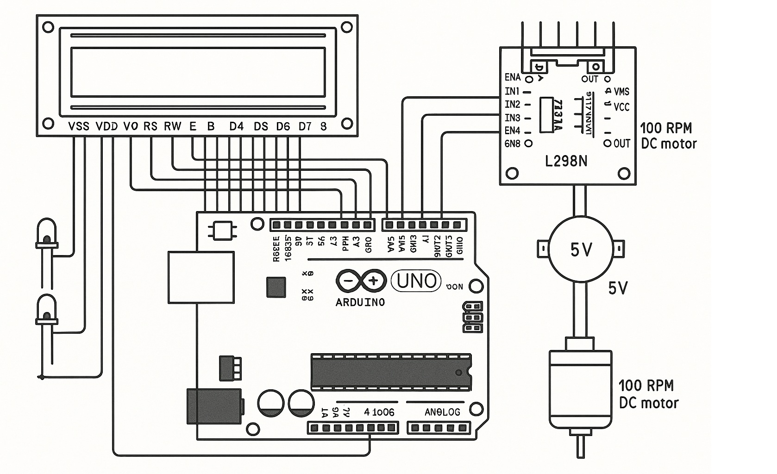
Circuit Diagram

Slide 11
Hardware Description:
Arduino Uno :
The Arduino Uno is a low-cost, open-source microcontroller board based on the ATmega328P microcontroller.
It is widely used in embedded systems, automation, and DIY electronics projects.
Features 14 digital input/output pins (of which 6 can be used as PWM outputs) and 6 analog input pins.
Operates at 16 MHz clock speed and uses a USB-B port for programming and power.
Has 32 KB of flash memory, 2 KB of SRAM, and 1 KB of EEPROM.
Supports standard 5V logic and can be powered via USB or an external power supply (7–12V recommended).
Includes a reset button, power and status LEDs, and an onboard voltage regulator.
Compatible with a wide range of shields and sensors, making it ideal for prototyping and educational use.
Easily programmed using the Arduino IDE, which supports C/C++ with simplified libraries.

Slide 12
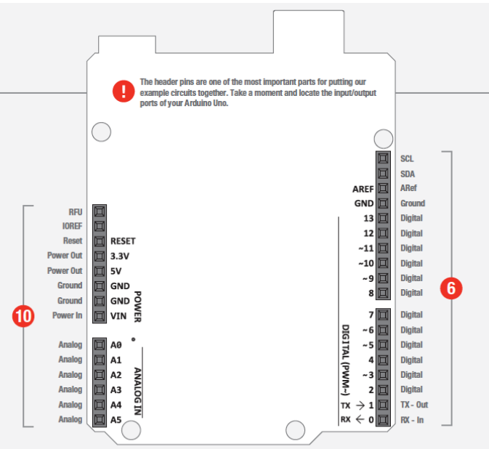
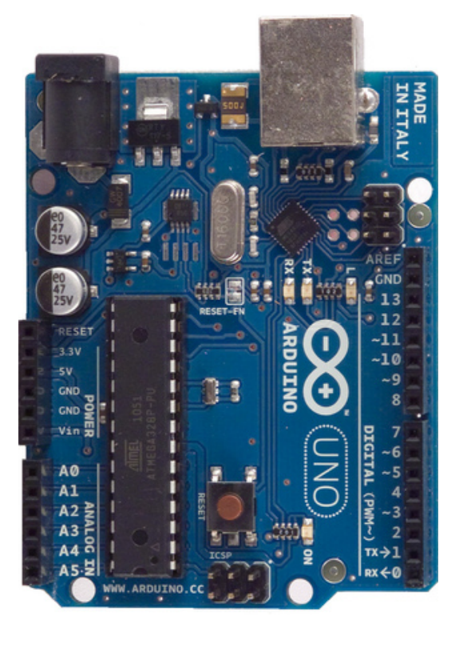

Slide 13
LCD:
A 16x2 LCD (Liquid Crystal Display) is used in this project.
It is an electronic display module and it has a wide range of applications.
The LCD used here is economical, easily programmable have no limitation of displaying special & even custom characters(unlike in seven segments),.
A 16x2 LCD means it can display 16 characters per line and there are 2 such lines. In this LCD each character is displayed in 5x7 pixel matrix.
This LCD has two registers, namely, Command and Data.

Slide 14
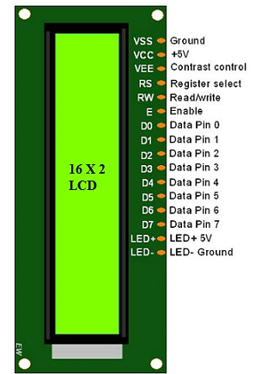
The command register stores the command instructions given to the LCD.
A command is an instruction given to LCD to do a predefined task like initializing it, clearing its screen, setting the cursor position, controlling display etc.
The data register stores the data to be displayed on the LCD. The data is the ASCII value of the character to be displayed on the LCD.
LCD Pin Diagram:

Slide 15
DC Motor (E-Bus Simulation)
A DC motor is an electrical machine that converts direct current (DC) electrical power into mechanical motion.
In this project, the DC motor is used to simulate the movement of an electric bus (E-Bus) in response to driver activity.
It replicates the forward motion of the bus, controlled by signals from the safety system.
The motor's operation is regulated based on eye detection results, simulating how a real E-Bus would react:
Normal state: Bus moves forward.
Drowsiness detected: Motor slows down or stops, mimicking autonomous stop.
Offers a practical and cost-effective way to demonstrate the autonomous response of an E-Bus in a controlled environment.
Controlled via the Arduino microcontroller and L298 motor driver for precise operation.

Slide 16
L298 MOTOR DRIVER
The L298 Motor Driver is a high-voltage, high-current dual full-bridge driver, ideal for controlling DC and stepper motors.
Used in this project to control the DC motor simulating the E-Bus movement.
Accepts standard TTL logic levels and drives inductive loads like DC motors.
Allows precise motor direction and speed control through logic inputs.

Slide 17
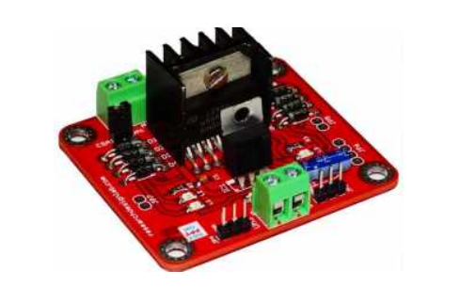
Key Features:
Supports operating voltage up to 46V
Handles DC current up to 4A total
Low saturation voltage for efficient performance
Over-temperature protection
High noise immunity with logic "0" up to 1.5V
Built-in 5V regulator for powering external components
Motor direction indicator LEDs
Schottky EMF-protection diodes for back EMF safety
Screw terminals for easy power and motor connections
High-quality FR4 PCB board with FPT certification

Slide 18

Buzzer
The buzzer is used in the project to alert the driver when short-duration eye closure is detected, indicating possible drowsiness or inattention.
It provides a clear, audible warning to prompt the driver to stay alert and focused.
Specifications:
Rated Voltage: 6V DC
Operating Voltage: 4V to 8V DC
Current Consumption: ≤30mA
Sound Output (10cm): ≥85dB
Tone: Continuous
Resonant Frequency: 2300 ±300Hz
Operating Temperature: -25°C to +80°C
Weight: 2g

Slide 19
SOFTWARE DESCRIPTION:
Python Programming (AI Eye Motion Detection)
Python was used as the primary programming language for implementing the AI-based Continuous Rapid Eye Motion (CREM) detection system.
Known for its simplicity, versatility, and powerful AI and image processing libraries, Python was ideal for this application.
Key Libraries Used:
OpenCV – For real-time video capture and image processing.
Dlib – For facial landmark detection and tracking eye regions.
Imutils – For image resizing and processing utilities.
Numpy – For numerical operations and frame analysis.
Serial – For communication between Python and the Arduino module.

Slide 20
Functionality in Project:
Captures live video feed from the camera.
Detects facial landmarks to locate eyes.
Monitors eye blink rate and closure duration.
Calculates eye aspect ratio (EAR) to determine if eyes are closed.
Sends signal to hardware module:
Short closure (< 3 sec): Sends alert to buzzer.
Prolonged closure (> 5 sec): Triggers autonomous mode and emergency lights.

Slide 21
Serial Communication:
Establishes a real-time connection between Python (software module) and Arduino (hardware module).
Receives signals (e.g., "ALERT" or "AUTONOMOUS") to trigger appropriate actions.
Fuzzy Logic Algorithm:
Implements fuzzy decision-making to handle uncertainty in eye closure duration.
Makes intelligent decisions based on:
Short eye closure → Triggers buzzer.
Prolonged eye closure → Activates autonomous stop and emergency lights.
Ensures smoother, human-like decision-making compared to binary logic.

Slide 22
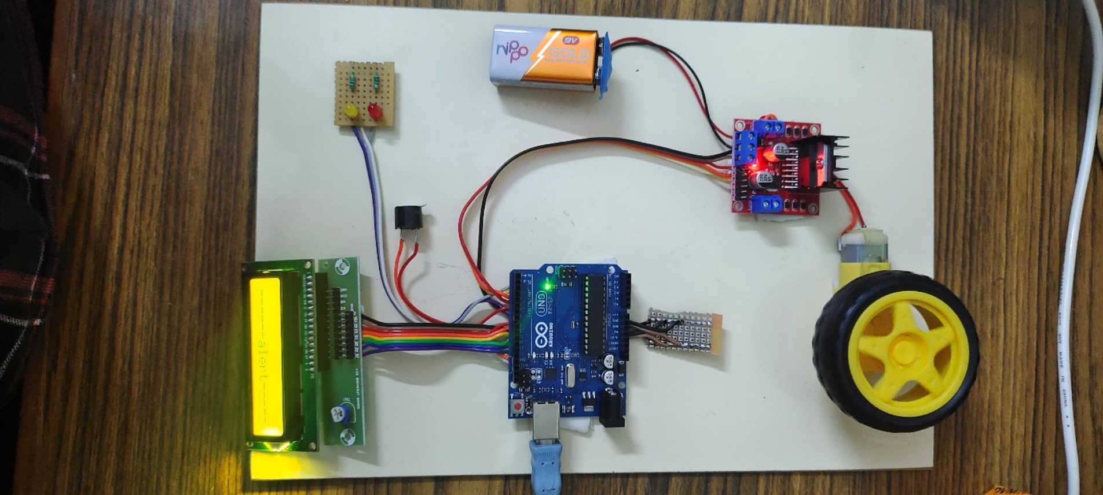
RESULT:
The hardware implementation of the system is shown:

Slide 23
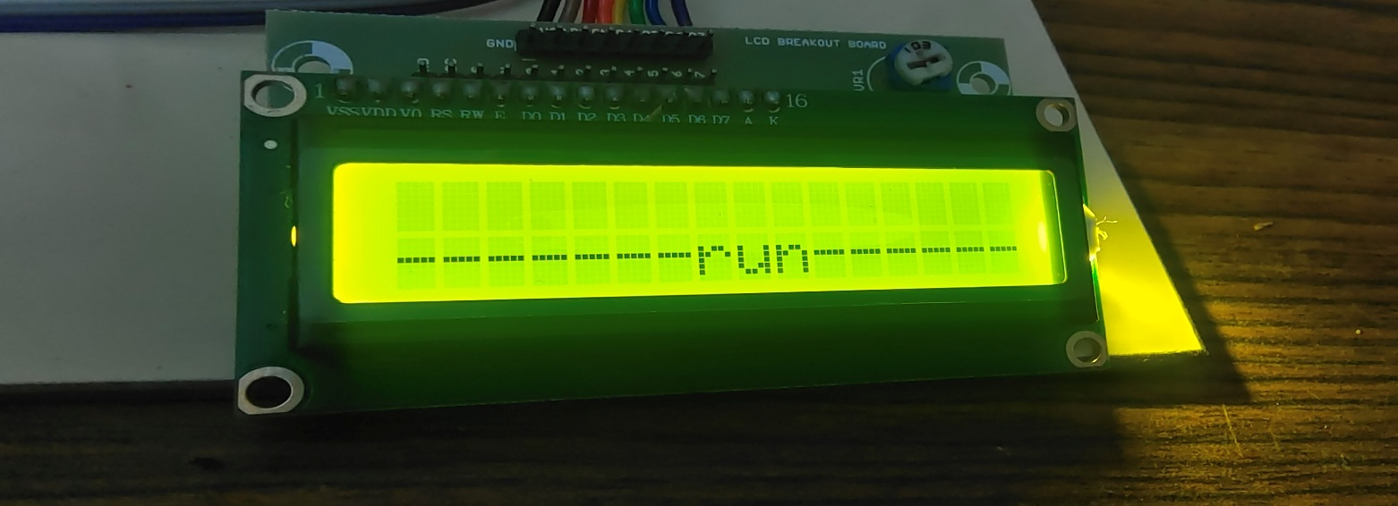
The System In Normal Operation Mode

Slide 24
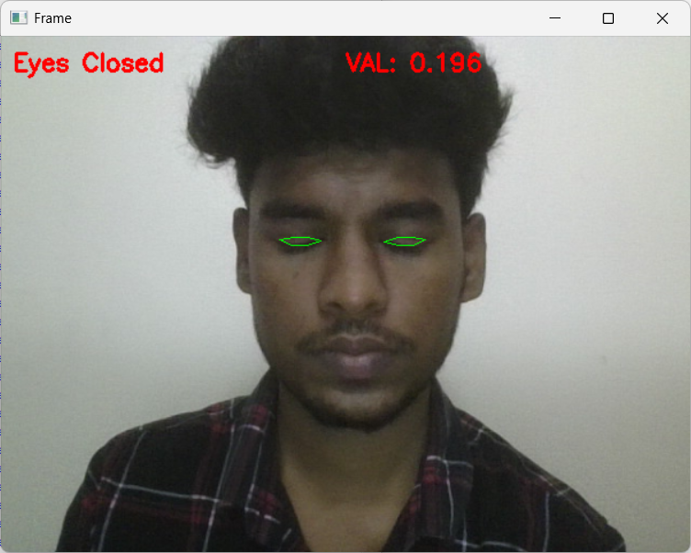
The Detection Of Short Eye Closure (Less Than 3 Seconds)

Slide 25
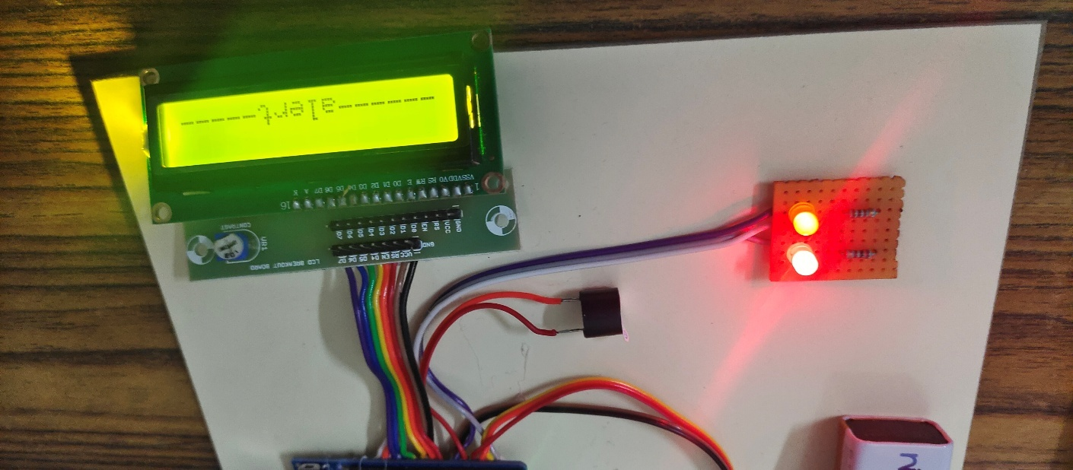
Activate The Buzzer And Emergency Alert LEDs Via Arduino

Slide 26
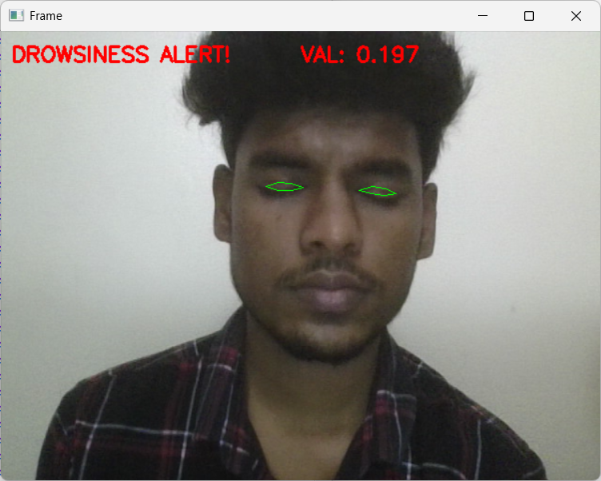
The Detection Of Prolonged Eye Closure (More Than 5 Seconds)

Slide 27
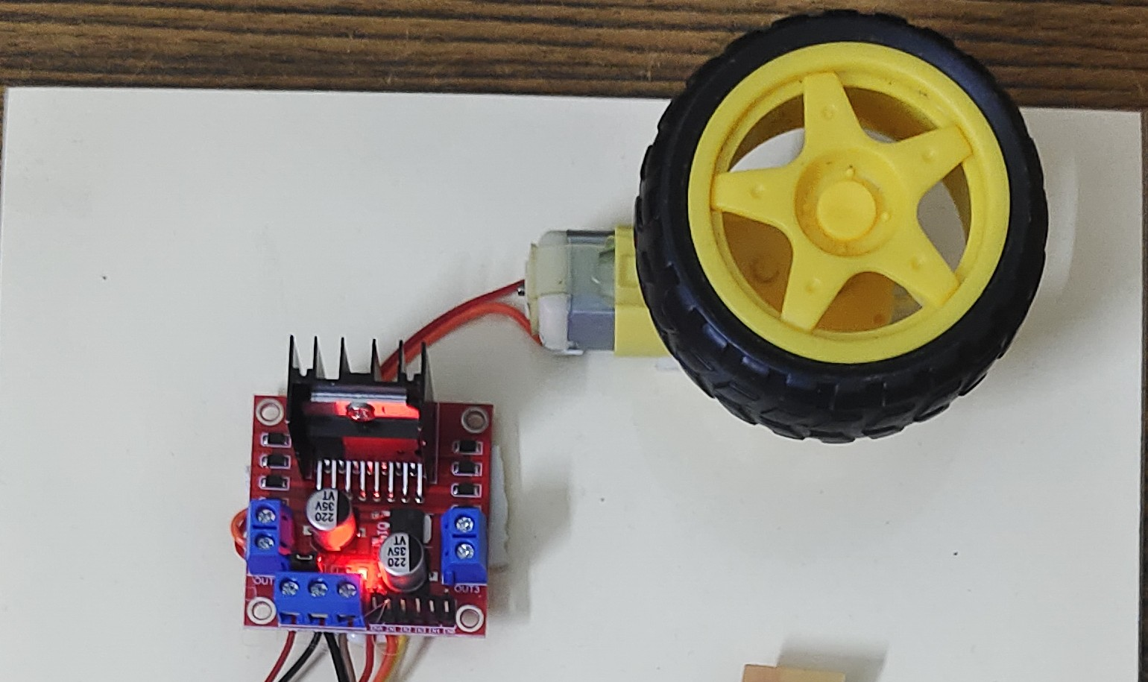
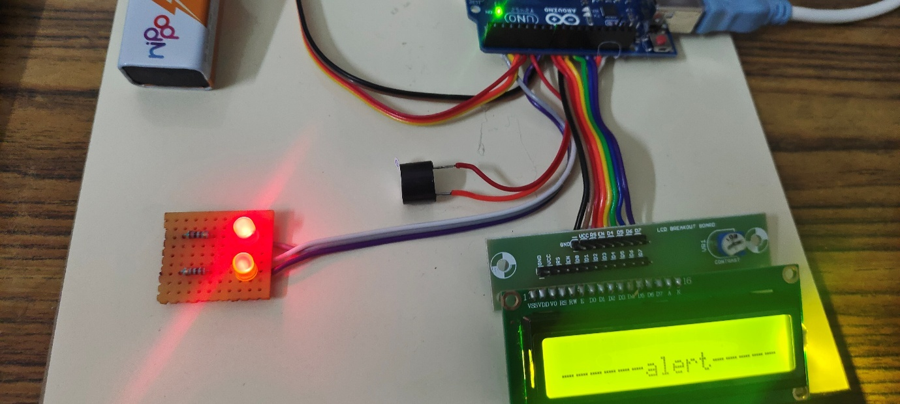
The DC Motor Gradually Slowing And Stopping With Emergency Warning Lights

Slide 28
Advantages
Real-time Driver Fatigue Detection
Enhances safety by instantly identifying signs of drowsiness or distraction.
Accident Prevention
Helps reduce the risk of collisions caused by inattentive or tired driving.
Integration with Safety Systems
Can work alongside existing ADAS and vehicle monitoring systems for enhanced functionality.
Enhanced Passenger Safety and Trust
Boosts public confidence in E-Bus transport through proactive safety measures.
Regulatory Compliance Support
Aids in meeting government and transport authority standards for driver monitoring.

Slide 29
Application
Public Transportation Systems Enhances safety in electric buses by monitoring driver alertness and enabling emergency response features.
Commercial Fleet Management Useful in logistics and delivery vehicles to reduce accidents caused by fatigue or driver inattention.
Emergency and Long-Distance Vehicles Ideal for ambulances, fire trucks, and long-haul buses where driver alertness is critical over extended hours.
Distraction Monitoring
Identifies when the driver is not focused on the road (e.g., looking away, inattentive).
Driver Behavior Analysis
Records data to help evaluate long-term driver performance and improve safety training.

Slide 30
Conclusion
This project successfully demonstrates an AI-based driver safety system using Continuous Rapid Eye Motion (CREM) detection for electric buses.
By monitoring the driver’s eye movements in real-time, the system can detect signs of drowsiness and respond immediately through alerts and autonomous intervention.
The integration of facial landmark detection, hardware control (Arduino, DC motor, L298 driver), and alert mechanisms (buzzer) ensures a multi-layered safety approach.
This solution offers a practical and scalable prototype for enhancing road safety in public transportation.
The project contributes to reducing road accidents caused by driver fatigue and supports the development of smarter, safer, and more reliable electric bus systems in the future.

Slide 31
References:
Smith, A., & Johnson, B. (2020). Eye-Tracking in Driver Drowsiness Detection Systems. Journal of Transportation Safety, 12(3), 145-157.
Gupta, R., & Patel, S. (2021). Advanced Safety Mechanisms in Autonomous Vehicles. International Journal of Automotive Engineering, 8(2), 88-99.
Lee, J., & Kim, D. (2018). Machine Learning Approaches for Detecting Driver Fatigue. Journal of Intelligent Transportation Systems, 15(4), 201-210.
Kumar, V., & Sharma, P. (2022). Applications of Fuzzy Logic in Automated Vehicle Systems. International Journal of Intelligent Systems, 30(1), 45-58.
Wilson, D., & Brown, C. (2020). Emergency Response Systems for Smart Vehicles. Journal of Smart Transportation, 6(3), 115-126.
Zhang, L., & Li, W. (2019). Enhancing Road Safety with Advanced Driver Assistance Systems. Safety Science Journal, 24(1), 77-89.
Patel, S., & Mehta, R. (2021). A Comparative Study of Drowsiness Detection Techniques. Journal of Vehicular Technology, 14(2), 150-162.

Slide 32
Chen, X., & Liu, Y. (2020). Integration of IoT in Vehicular Safety Systems. International Journal of IoT Applications, 10(3), 99-111.
Anderson, M., & Garcia, E. (2019). The Role of Artificial Intelligence in Enhancing Vehicle Safety. Journal of AI Research in Transportation, 7(4), 188-202.
Singh, H., & Kaur, A. (2022). Real-Time Drowsiness Detection Using Facial Landmarks. Journal of Advanced Robotics and Automation, 9(1), 22-34.
Davis, P., & Roberts, J. (2020). Fuzzy Logic for Autonomous Vehicle Decision Making. International Journal of Robotics and Automation, 18(3), 134-145.
Thompson, R., & Lee, M. (2021). Safety Enhancements in Electric Buses Through Advanced Monitoring Systems. Journal of Electric Vehicle Technology, 5(2), 101-112.
Wang, S., & Chen, L. (2019). Smart Sensors for Enhanced Driver Safety in Public Transport. Journal of Smart Sensors and Systems, 3(4), 175-188.
Martin, N., & Thomas, K. (2020). Vehicle-to-Vehicle Communication for Improving Road Safety. Journal of Connected Vehicles, 11(2), 144-156.
Hernandez, P., & Wilson, J. (2021). The Impact of Autonomous Mode Activation on Passenger Safety. Journal of Autonomous Vehicle Systems, 8(3), 215-226.

Slide 33
THANK YOU

